Slide 1
loss, optimization and scheduling

Slide 2
Loss (or cost) function

Slide 3

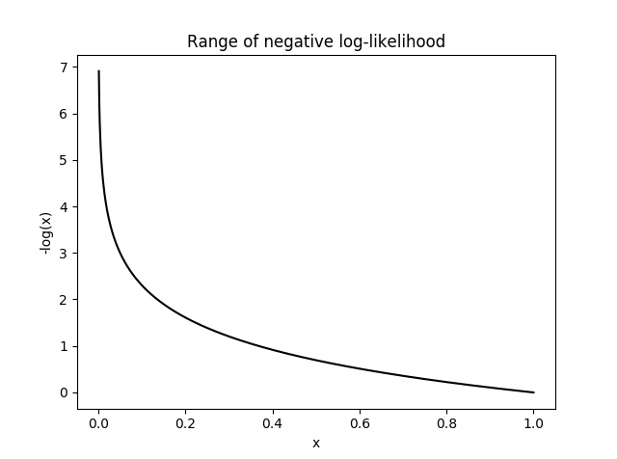
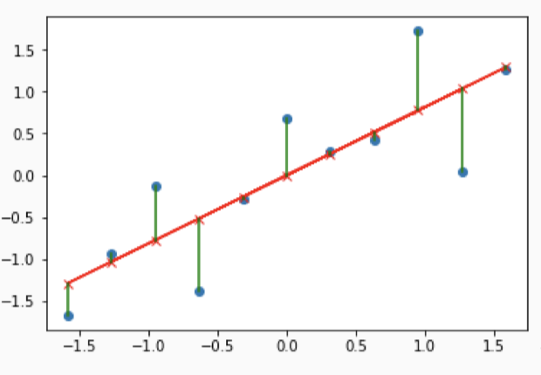
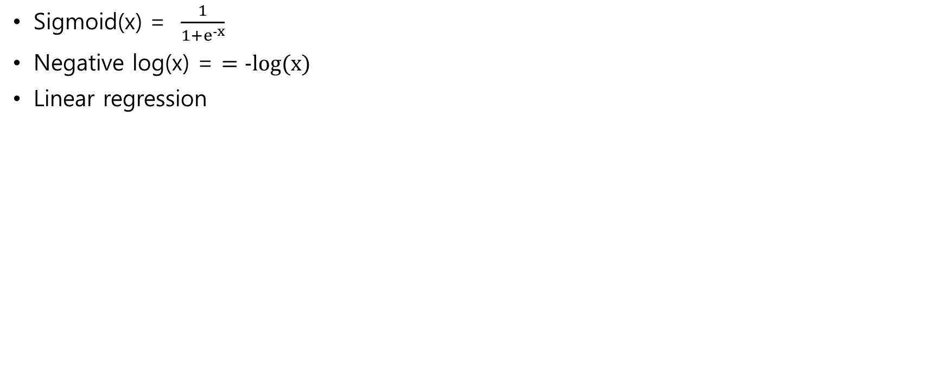
What we have learned
Sigmoid(x) = $\frac{1}{1+e^{−x}}$
Negative log(x) = $=−log(x)$
Linear regression
Sigmoid
Negative log
Linear regression

Slide 4

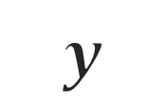

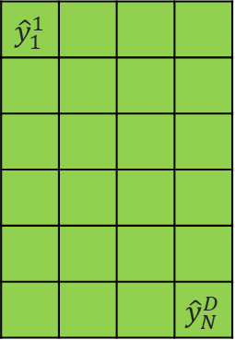

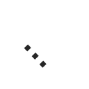
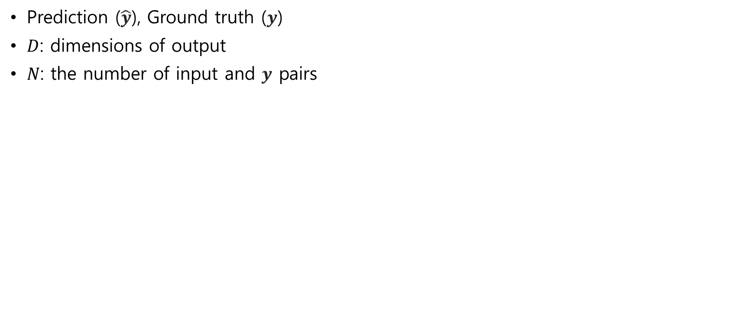




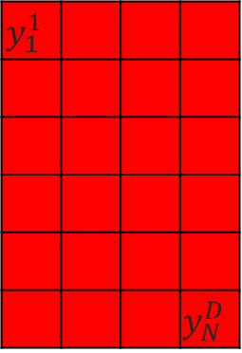
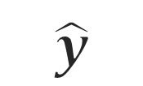
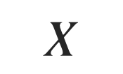
What we have learned
Prediction ($\hat{y}$), Ground truth ($y$)
$D$: dimensions of output
$N$: the number of input and $y$ pairs
$$N$$
$$D$$
$$D$$
$$…$$
${\hat{y}}_{1}^{1}$
 |  |  | ${\hat{y}}_{N}^{D}$
$$y_{1}^{1}$$
 |  |  | $$y_{N}^{D}$$
conv
$$\hat{y}$$
$$y$$
$$X$$
$$N$$
$$N$$
$$w$$
linear
inputs
Weights
Outputs
Ground truth

Slide 5

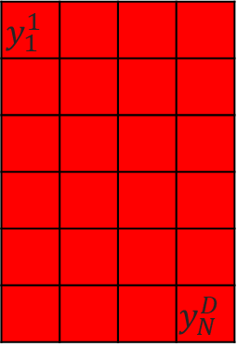
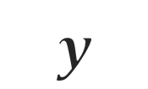
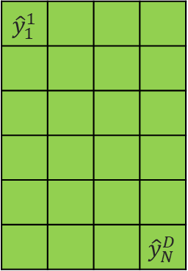




Loss – how much difference between true and pred
Loss: difference between predicted values and true values of
The goal of deep learning: minimize the loss
Used for back propagation (optimization)
Regression loss functions
Binary Classification Loss Functions
Multi-class Classification Loss Functions
Other loss functions
$$D$$
$$D$$
${\hat{y}}_{1}^{1}$
 |  |  | ${\hat{y}}_{N}^{D}$
$$y_{1}^{1}$$
 |  |  | $$y_{N}^{D}$$
$$\hat{y}$$
$$y$$
$$N$$
loss
$$N$$

Slide 6
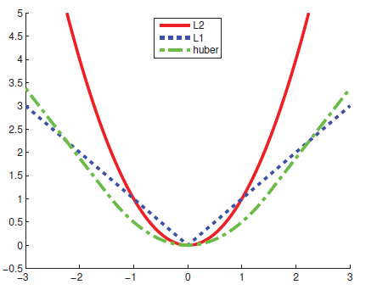


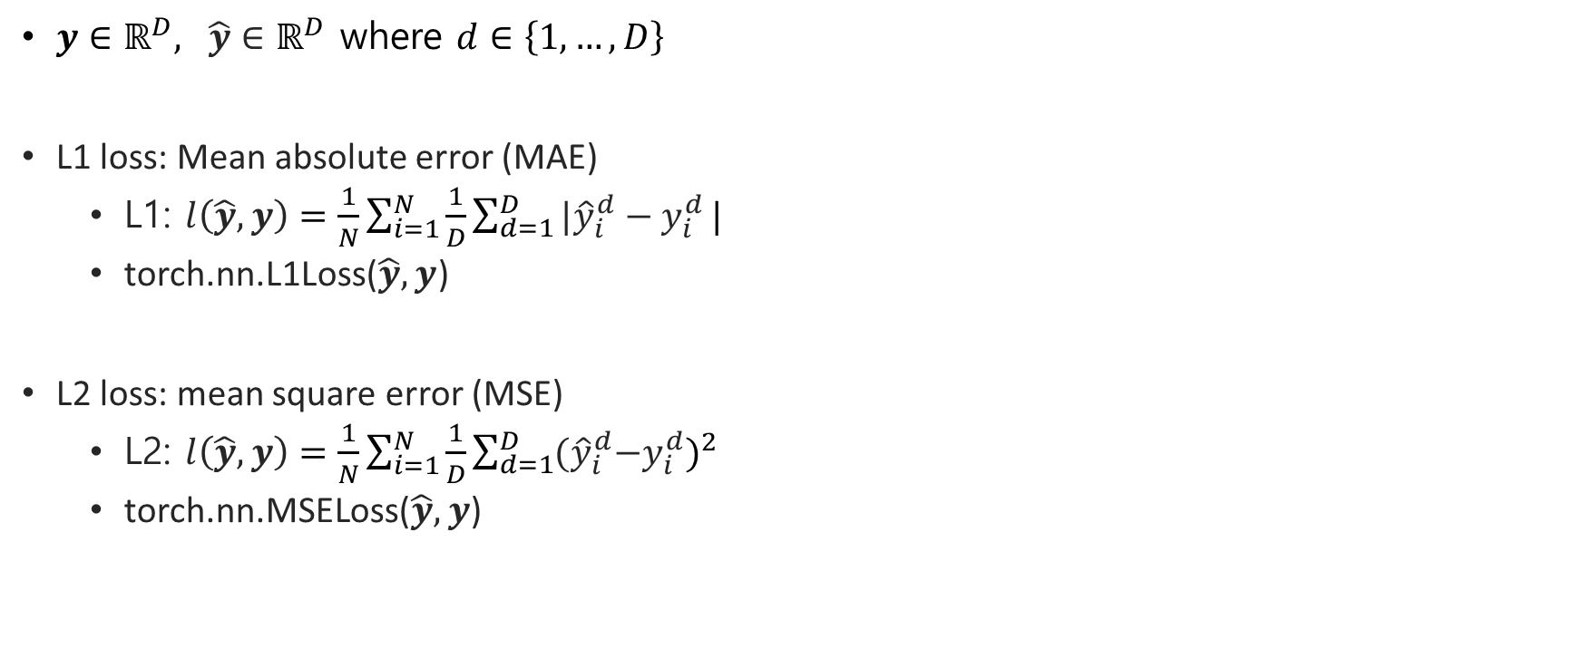



L1 loss, L2 loss - regression
$y∈ℝ^{D}, \hat{y}∈ℝ^{D}$ where $d∈\left\{1,…,D\right\}$
L1 loss: Mean absolute error (MAE)
L1: $l\left(\hat{y},y\right)=\frac{1}{N}\sum_{i=1}^{N}{\frac{1}{D}\sum_{d=1}^{D}{{|\hat{y}}_{i}^{d}−y_{i}^{d}}|}$
torch.nn.L1Loss($\hat{y},y$)
L2 loss: mean square error (MSE)
L2: $l\left(\hat{y},y\right)=\frac{1}{N}\sum_{i=1}^{N}{\frac{1}{D}\sum_{d=1}^{D}{{(\hat{y}}_{i}^{d}−y_{i}^{d}})^{2}}$
torch.nn.MSELoss($\hat{y},y$)
https://process-mining.tistory.com/130
$$D$$
$$D$$
0.5 | -1 | 9 | 7.2
1.1 | -2 | 7 | 5.2
$$\hat{y}$$
$$y$$
$$N$$

Slide 7



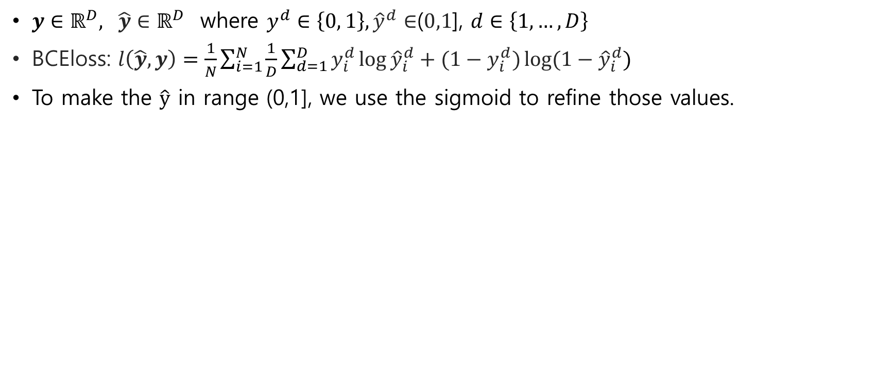



Binary cross entropy loss – multilabel, binary cls
$y∈ℝ^{D}, \hat{y}∈ℝ^{D}$ where $y^{d}∈\left\{0, 1\right\}, {\hat{y}}^{d}∈$($0,1$], $d∈\left\{1,…,D\right\}$
BCEloss: $l\left(\hat{y},y\right)=\frac{1}{N}\sum_{i=1}^{N}{\frac{1}{D}\sum_{d=1}^{D}{y_{i}^{d}\log{{\hat{y}}_{i}^{d}}}+(1−y_{i}^{d})\log{{(1−\hat{y}}_{i}^{d}}})$
To make the $\hat{y}$ in range (0,1], we use the sigmoid to refine those values.
$$D$$
$$D$$
0.3 | 0.1 | 0.8 | 0.1
1 | 0 | 1 | 0
$$N$$
$$\hat{y}$$
$$y$$
$$N$$

Slide 8



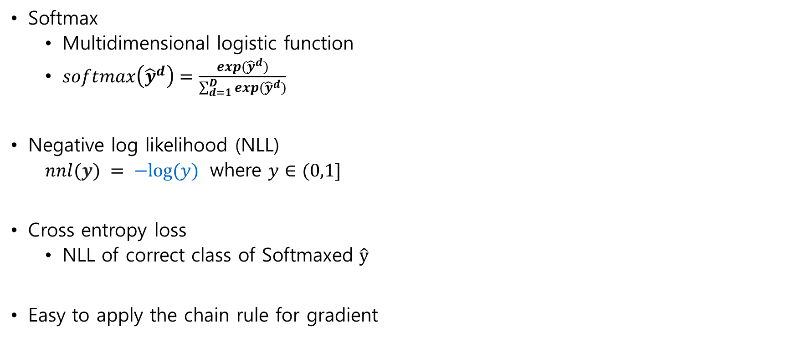
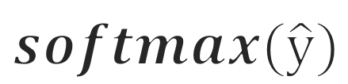
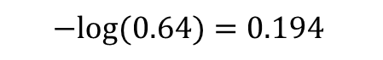



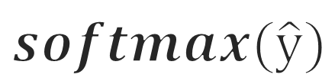
Cross entropy loss - classification
$$D$$
$$D$$
4 | 5 | 6 | 7
0.03 | 0.08 | 0.23 | 0.64
Softmax
Multidimensional logistic function
$softmax\left({\hat{y}}^{d}\right)=\frac{exp({\hat{y}}^{d})}{\sum_{d=1}^{D}{exp({\hat{y}}^{d})}}$
Negative log likelihood (NLL)
$nnl(y) = −log⁡(y)$ where $y∈(0,1]$
Cross entropy loss
NLL of correct class of Softmaxed $\hat{y}$
Easy to apply the chain rule for gradient
$$N$$
$$\hat{y}$$
$$softmax(\hat{y})$$
$$D$$
0.03 | 0.08 | 0.23 | 0.64
$$−log⁡(0.64)=0.194$$
4
$$softmax(\hat{y})$$
$$y$$

Slide 9
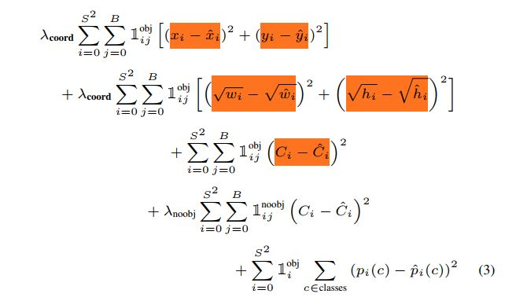
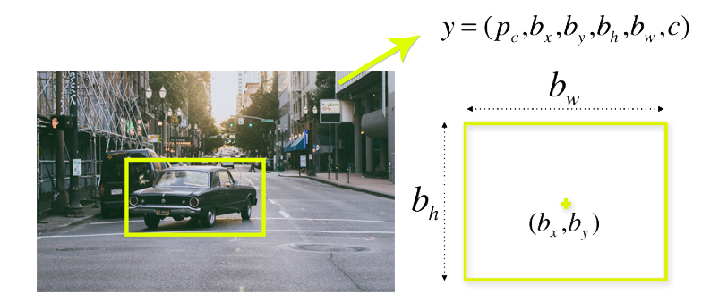
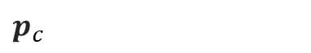
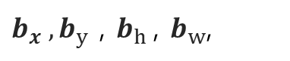
Combination of loss
Several losses can be combined for better results.
Ex) object detection: classification loss + regression loss
$b_{x}{ ,b}_{y}$ , $b_{h}$, $b_{w}$,
$p_{c}$
https://www.kdnuggets.com/2018/09/object-detection-image-classification-yolo.html
https://stats.stackexchange.com/questions/319243/object-detection-loss-function-yolo?rq=1

Slide 10
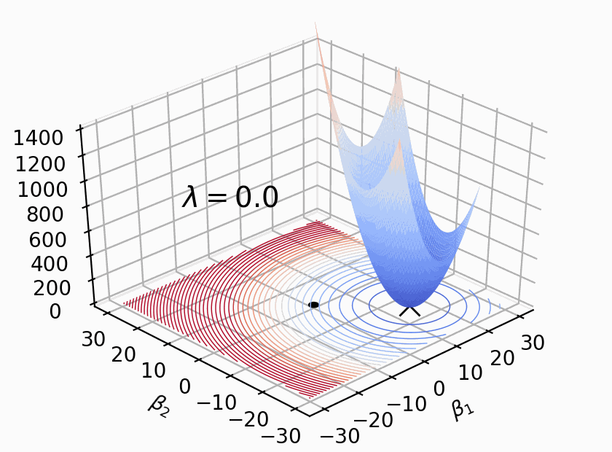
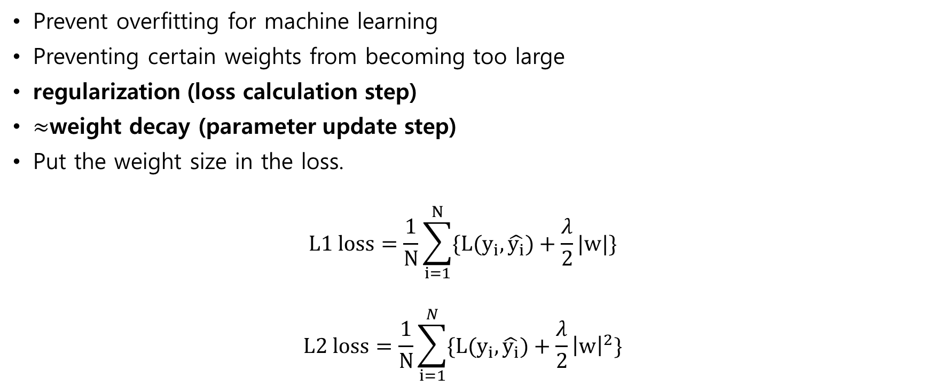

Regularization – an add-on
$$w$$
Prevent overfitting for machine learning
Preventing certain weights from becoming too large
regularization (loss calculation step)
$≈$weight decay (parameter update step)
Put the weight size in the loss.
$$L1 loss=\frac{1}{N}\sum_{i=1}^{N}{\{L(y_{i},\hat{y_{i}})+\frac{λ}{2}|w|\}}$$
$$L2 loss=\frac{1}{N}\sum_{i=1}^{N}{\{L(y_{i},\hat{y_{i}})+\frac{λ}{2}{\left|w\right|}^{2}\}}$$
linear
Weights

Slide 11
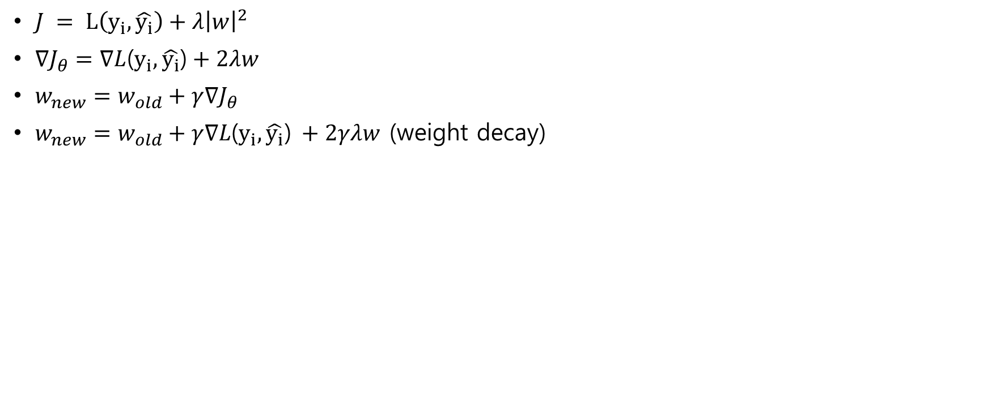
Regularization – L2 norm in Cost function is similar as weight decay
$J = L\left(y_{i},\hat{y_{i}}\right)+λ{\left|w\right|}^{2}$
$∇J_{θ}=∇L$($y_{i},\hat{y_{i}}$)$+ 2λw$
$w_{new}=w_{old}+γ∇J_{θ}$
$w_{new}=w_{old}+γ∇L\text{(}y_{i},\hat{y_{i}}\text{)} +2γλw$ (weight decay)

Slide 12
Optimization

Slide 13
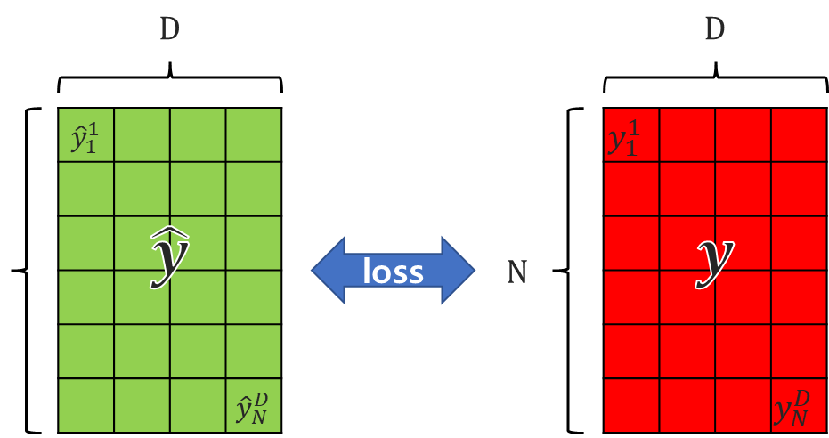
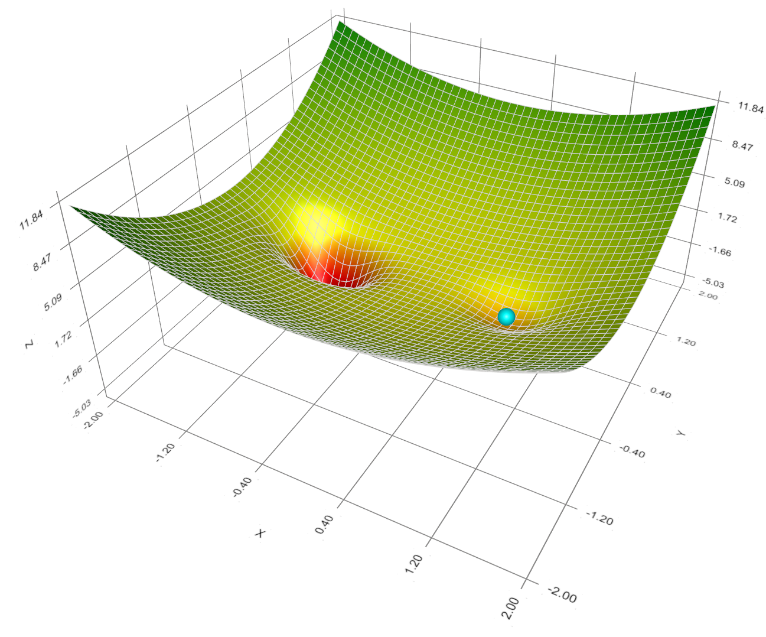




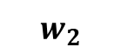

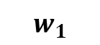
Optimization – how to decrease?
Gradient descent.
Here we only care about weight and loss
$$w$$
Loss
Loss
$$0.05$$
$w_{2}$
Loss
$$w_{46}$$
$w_{1}$
$$0.35$$

Slide 14
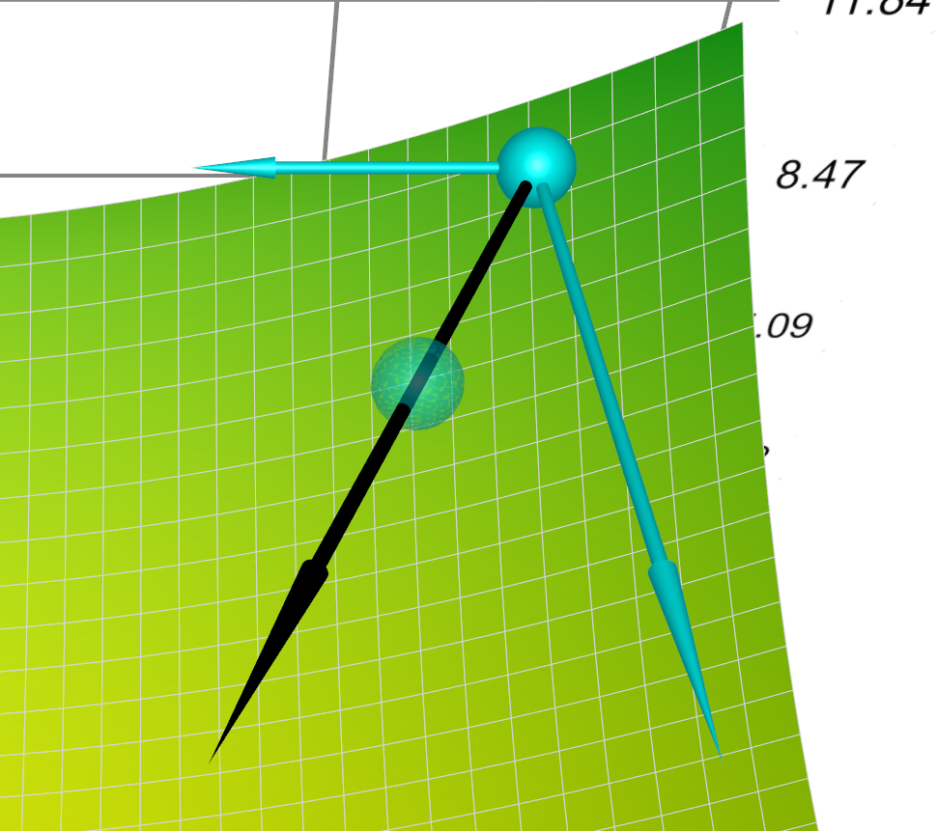
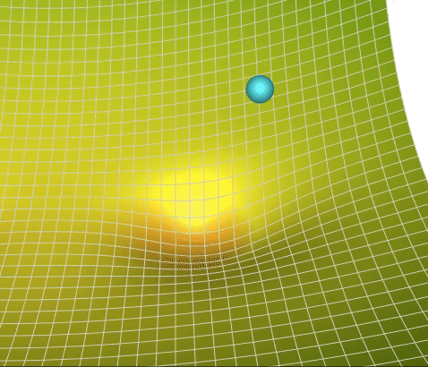
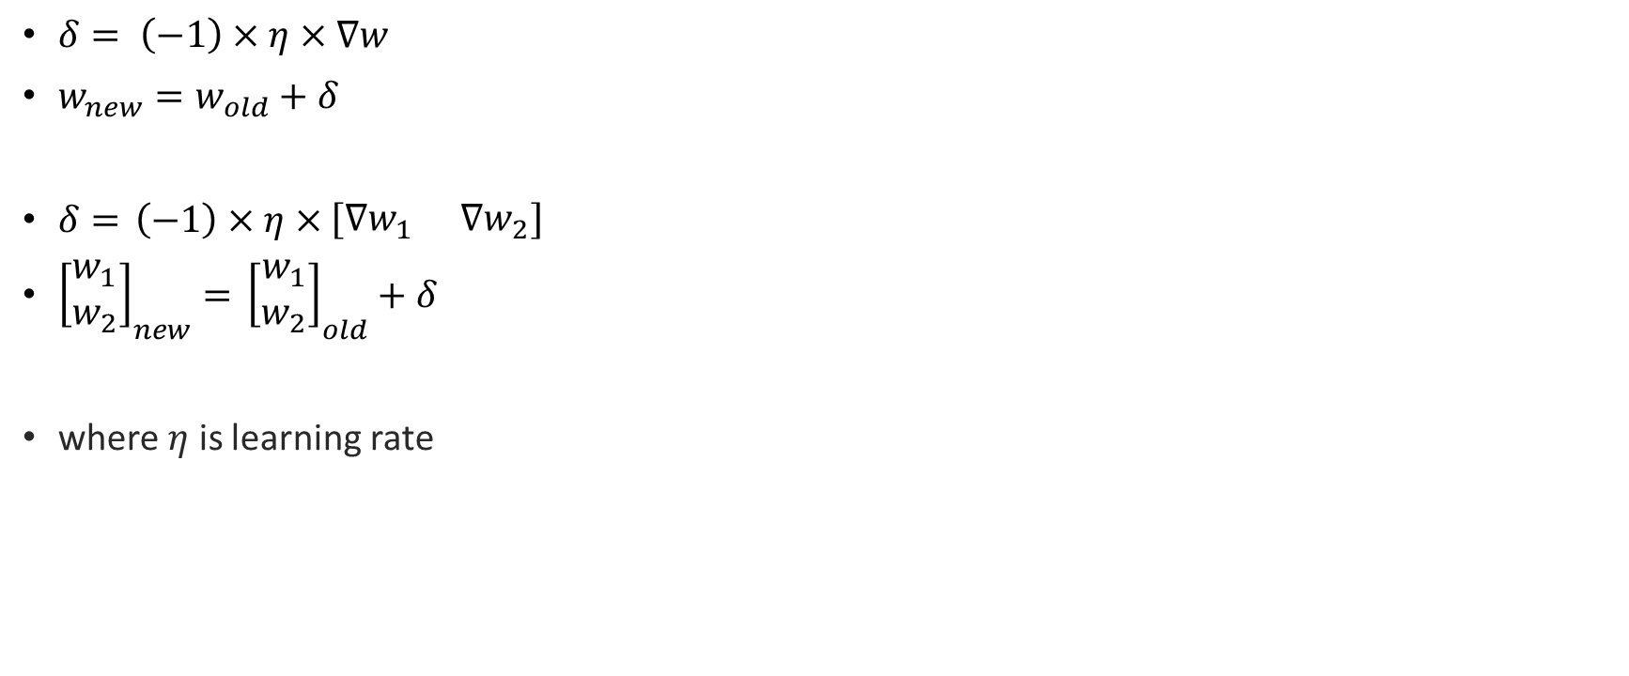
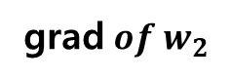
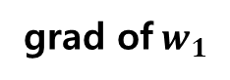
Optimization – Gradient descent
$δ= \left(−1\right)×η×∇w$
$w_{new}=w_{old}+δ$
$δ=$ $\left(−1\right)×η×\left[\begin{matrix}∇w_{1} & ∇w_{2}\end{matrix}\right]$
${\left[\begin{matrix}w_{1} \\ w_{2}\end{matrix}\right]}_{new}=$ ${\left[\begin{matrix}w_{1} \\ w_{2}\end{matrix}\right]}_{old}+δ$
where $η$ is learning rate
grad of${ w}_{1}$
Total grad
grad${ of w}_{2}$
step scaled by learning rate

Slide 15
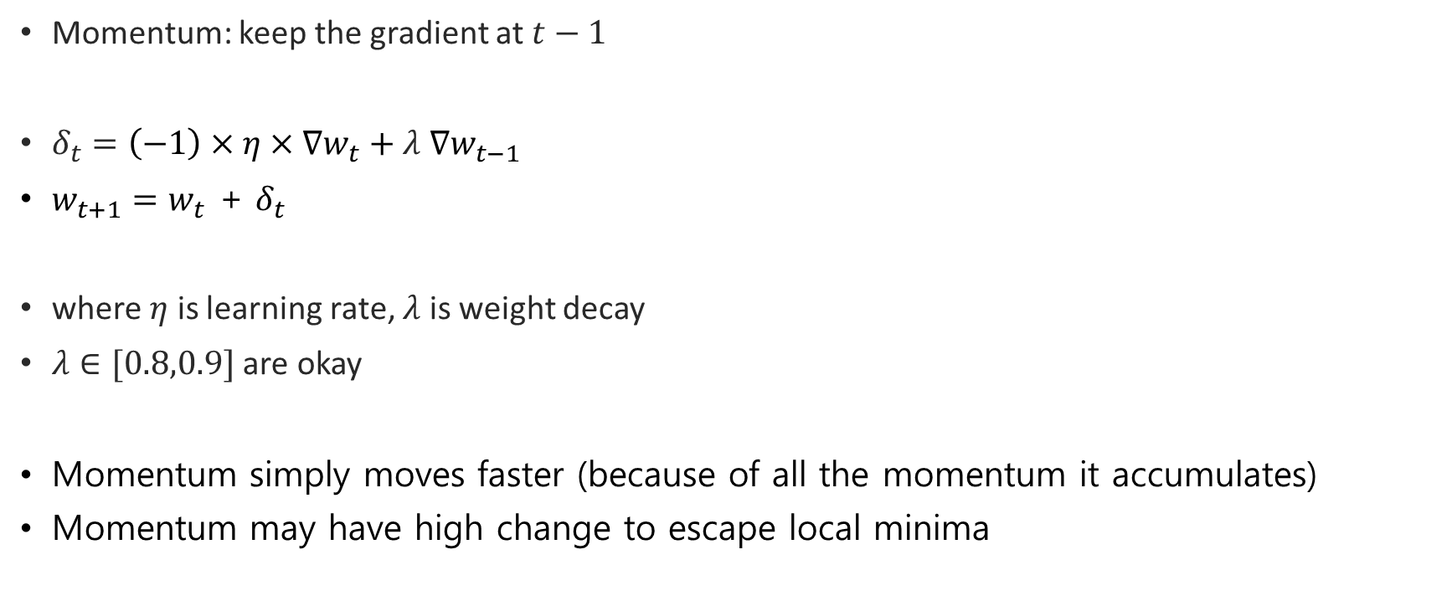
Optimization – Gradient descent + momentum
Momentum: keep the gradient at $t−1$
$δ_{t}=\left(−1\right)×η×∇w_{t}+$ $λ$ $∇w_{t−1}$
$w_{t+1}=w_{t}$ + $δ_{t}$
where $η$ is learning rate, $λ$ is weight decay
$λ∈[0.8,0.9]$ are okay
Momentum simply moves faster (because of all the momentum it accumulates)
Momentum may have high change to escape local minima
grad at t-1
(Momentum)
Actual move
grad at t

Slide 16
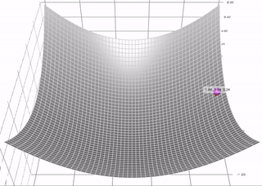
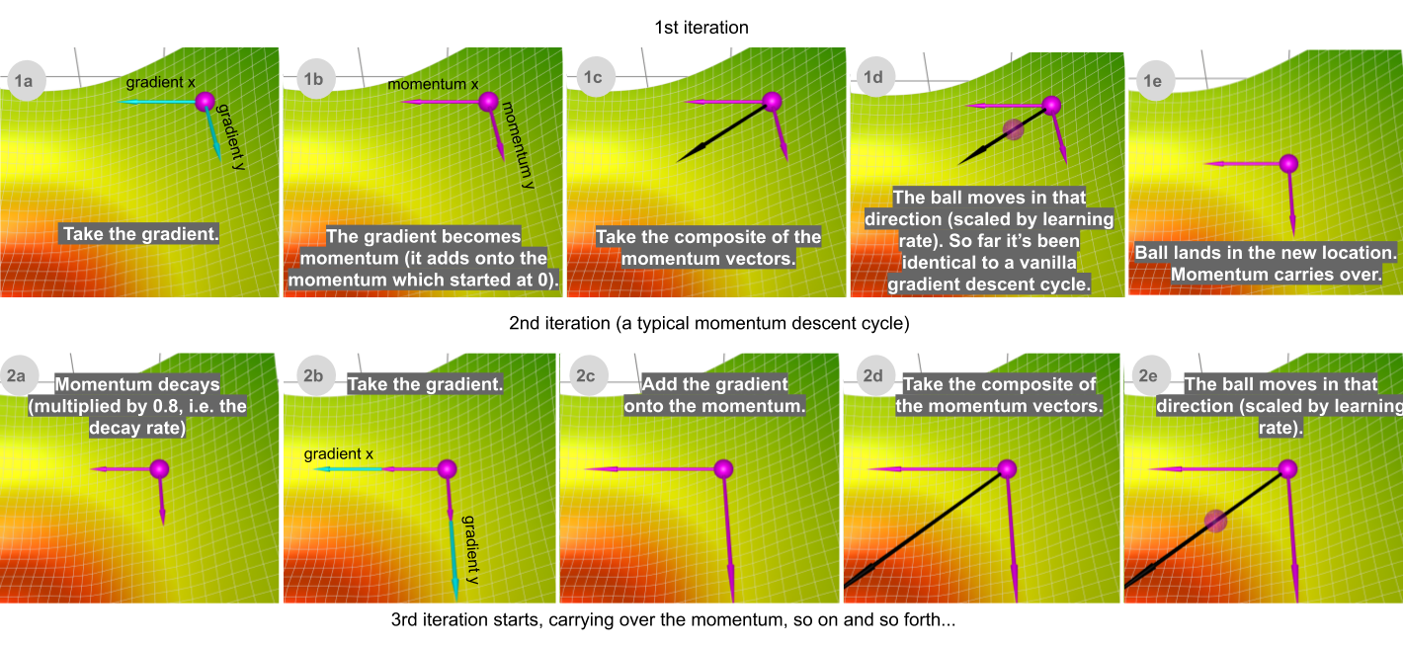
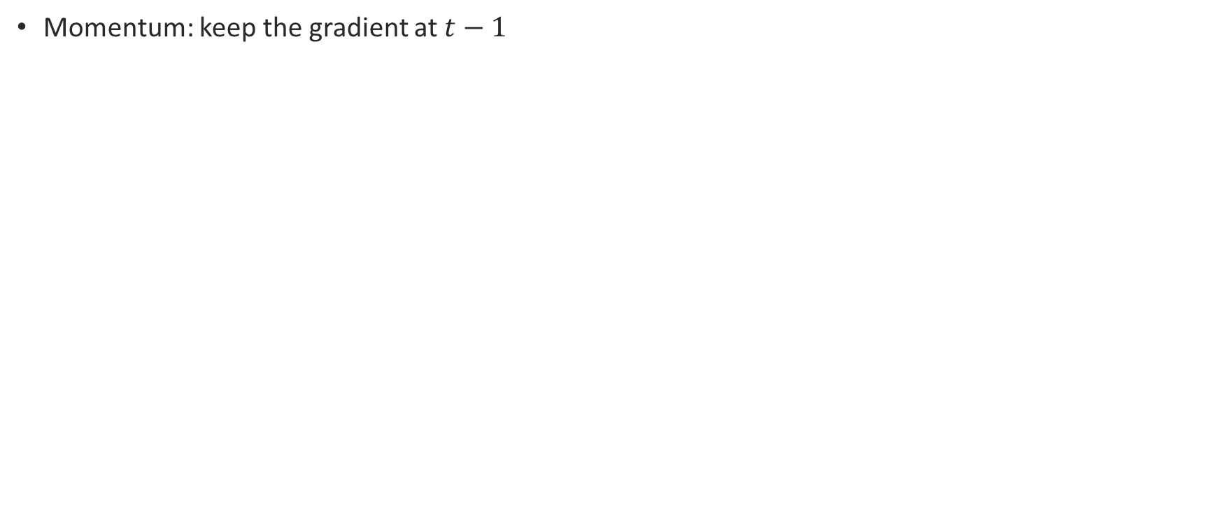
Optimization – Gradient descent + momentum
Momentum: keep the gradient at $t−1$

Slide 17
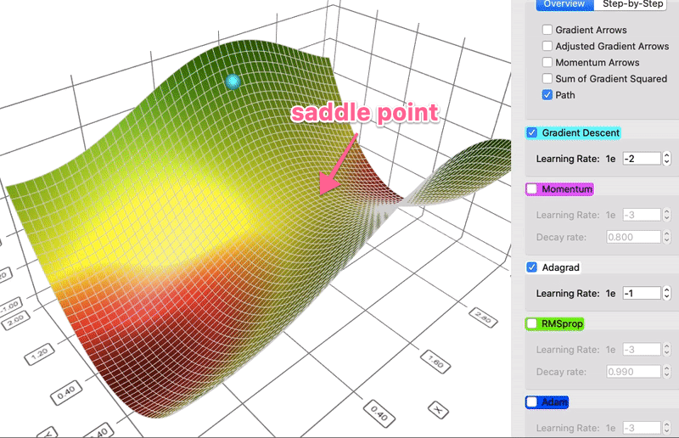
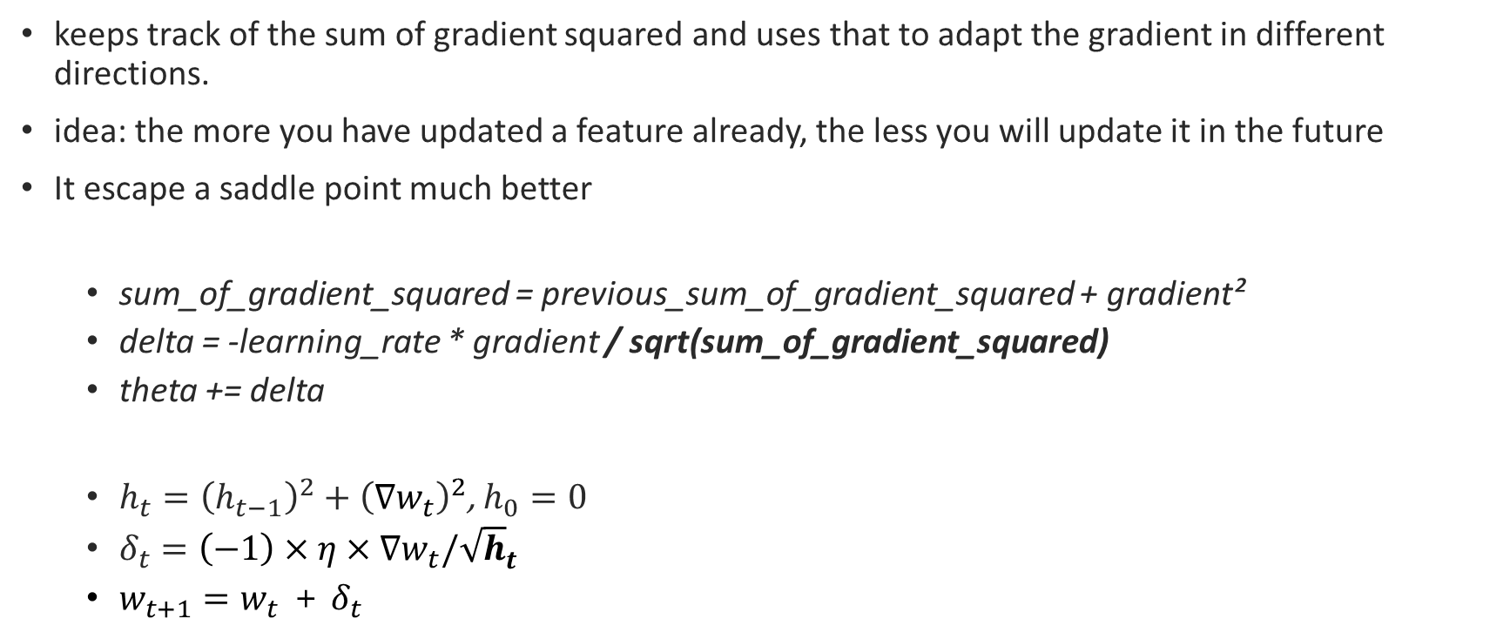
Optimization – Adagrad (Adaptive Gradient algorithm)
keeps track of the sum of gradient squared and uses that to adapt the gradient in different directions.
idea: the more you have updated a feature already, the less you will update it in the future
It escape a saddle point much better
sum_of_gradient_squared = previous_sum_of_gradient_squared + gradient²
delta = -learning_rate * gradient / sqrt(sum_of_gradient_squared)
theta += delta
$h_{t}={\left(h_{t−1}\right)}^{2}+{\left(∇w_{t}\right)}^{2}$, $h_{0}=0$
$δ_{t}=\left(−1\right)×η×∇w_{t}/{\sqrt{h}}_{t}$
$w_{t+1}=w_{t}$ + $δ_{t}$

Slide 18
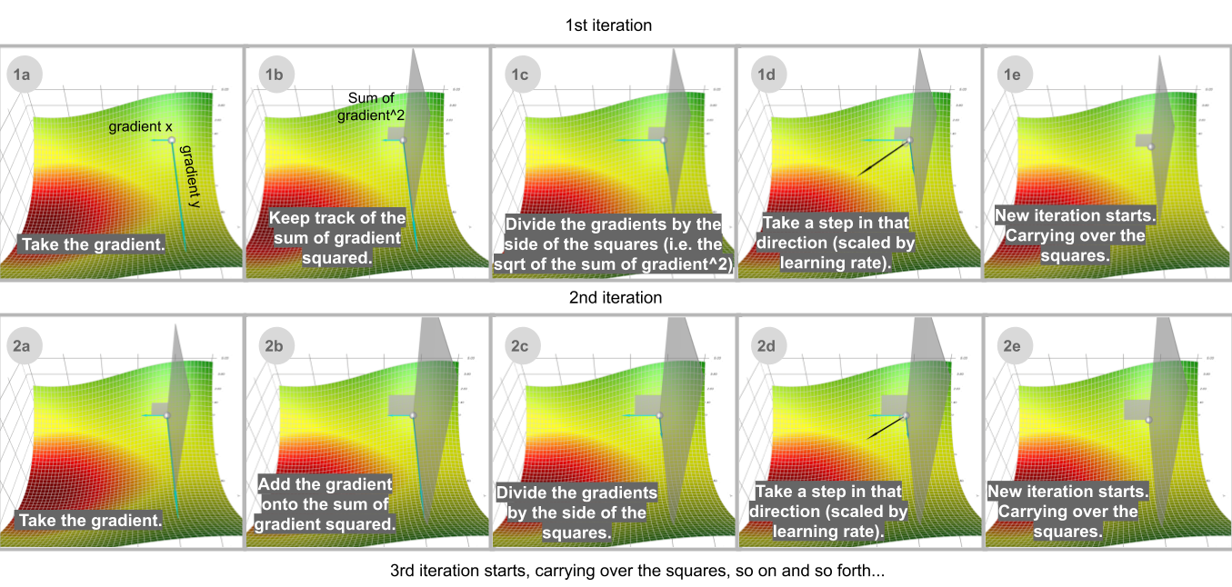
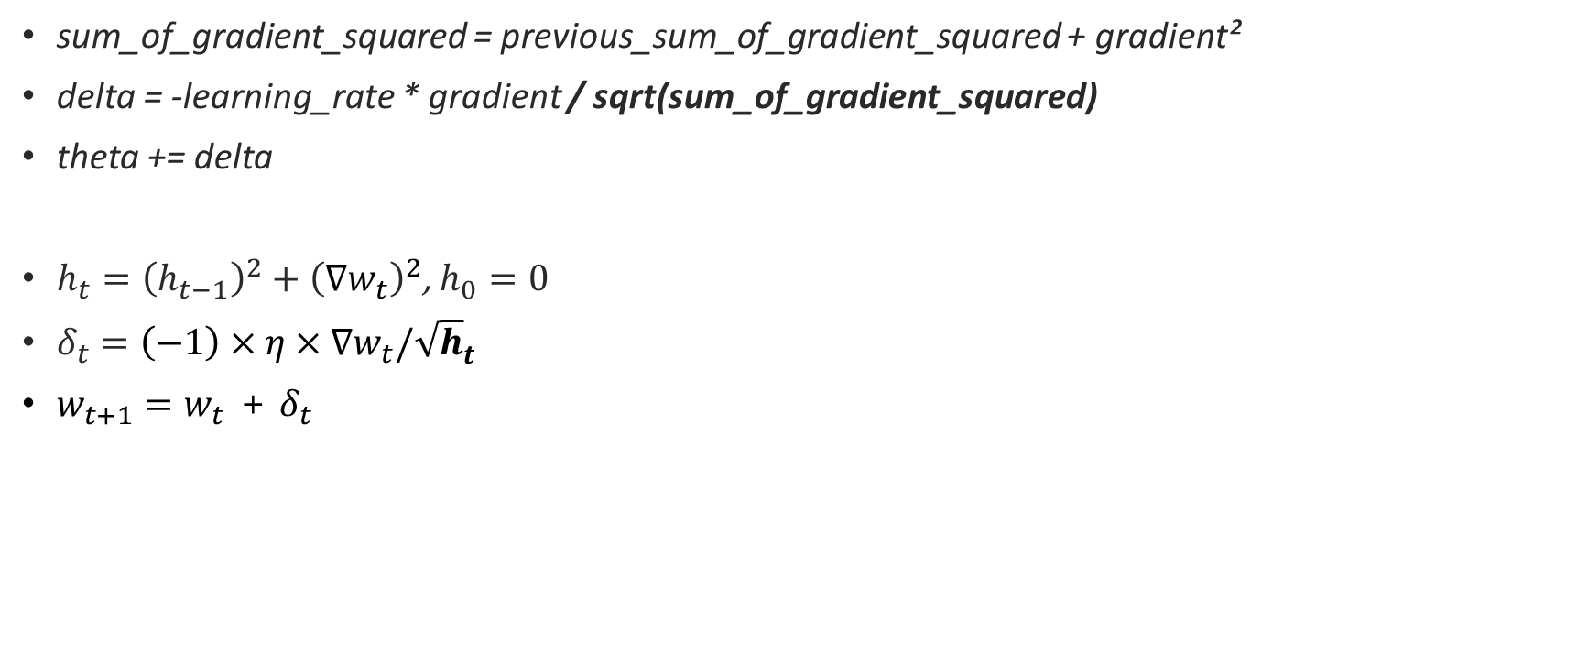
Optimization – Adagrad (Adaptive Gradient algorithm)
sum_of_gradient_squared = previous_sum_of_gradient_squared + gradient²
delta = -learning_rate * gradient / sqrt(sum_of_gradient_squared)
theta += delta
$h_{t}={\left(h_{t−1}\right)}^{2}+{\left(∇w_{t}\right)}^{2}$, $h_{0}=0$
$δ_{t}=\left(−1\right)×η×∇w_{t}/{\sqrt{h}}_{t}$
$w_{t+1}=w_{t}$ + $δ_{t}$

Slide 19
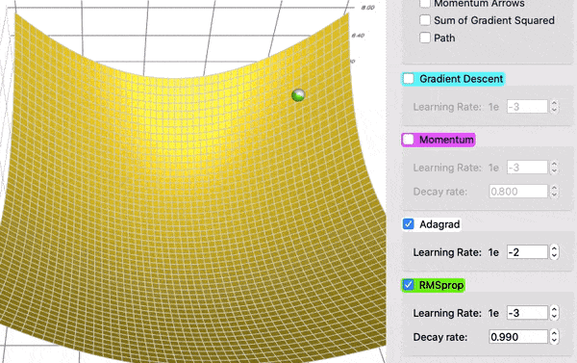
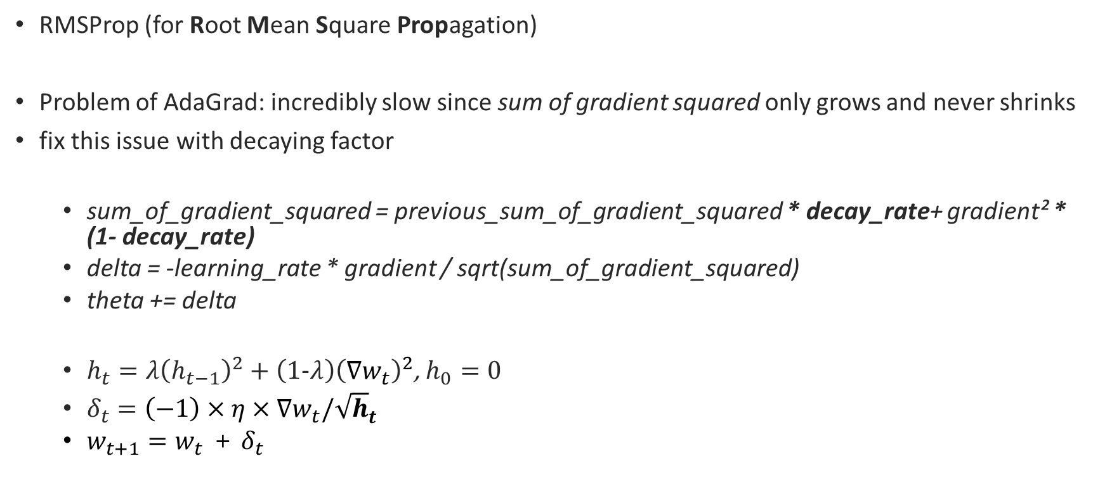
Optimization – RMSprop
RMSProp (for Root Mean Square Propagation)
Problem of AdaGrad: incredibly slow since sum of gradient squared only grows and never shrinks
fix this issue with decaying factor
sum_of_gradient_squared = previous_sum_of_gradient_squared * decay_rate+ gradient² * (1- decay_rate)
delta = -learning_rate * gradient / sqrt(sum_of_gradient_squared)
theta += delta
$h_{t}={λ\left(h_{t−1}\right)}^{2}+{\left(1−λ\right)\left(∇w_{t}\right)}^{2}$, $h_{0}=0$
$δ_{t}=\left(−1\right)×η×∇w_{t}/{\sqrt{h}}_{t}$
$w_{t+1}=w_{t}$ + $δ_{t}$

Slide 20
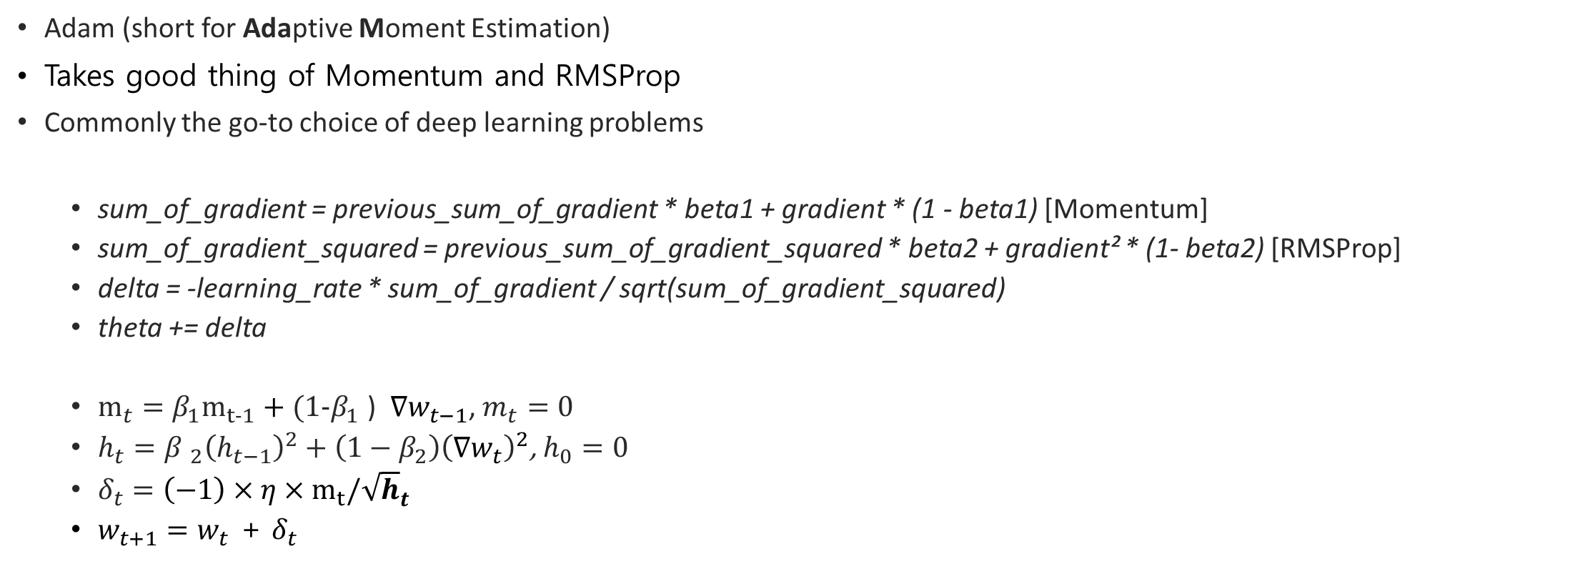
Optimization – Adam
Adam (short for Adaptive Moment Estimation)
Takes good thing of Momentum and RMSProp
Commonly the go-to choice of deep learning problems
sum_of_gradient = previous_sum_of_gradient * beta1 + gradient * (1 - beta1) [Momentum]
sum_of_gradient_squared = previous_sum_of_gradient_squared * beta2 + gradient² * (1- beta2) [RMSProp]
delta = -learning_rate * sum_of_gradient / sqrt(sum_of_gradient_squared)
theta += delta
$m_{t}={β_{1}m}_{t−1}+$ $(1−β_{1}$ ) $∇w_{t−1}$, $m_{t}=0$
$h_{t}={{β }_{2}\left(h_{t−1}\right)}^{2}+{\left(1−β_{2}\right)\left(∇w_{t}\right)}^{2}$, $h_{0}=0$
$δ_{t}=\left(−1\right)×η×m_{t}/{\sqrt{h}}_{t}$
$w_{t+1}=w_{t}$ + $δ_{t}$

Slide 21
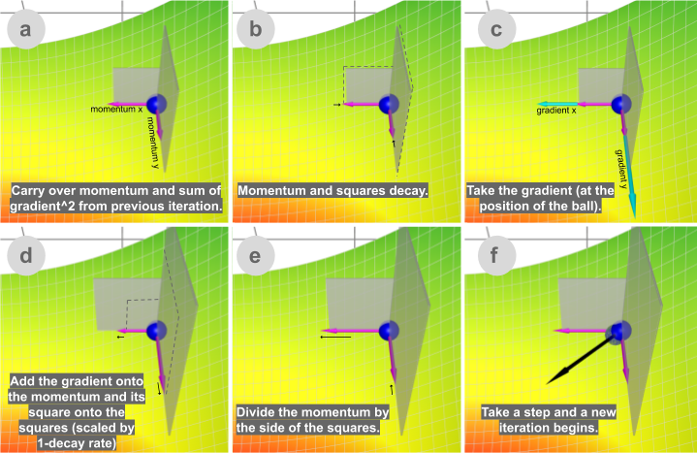
Optimization – Adam

Slide 22
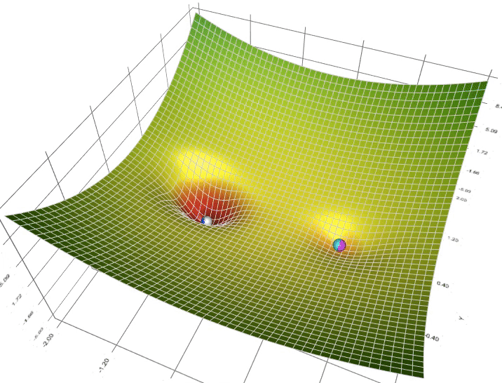
Gradient descent visualization
Animation of 5 gradient descent methods on a surface:
gradient descent (cyan),
momentum (magenta)
AdaGrad (white)
RMSProp (green)
Adam (blue).
Left well is the global minimum;
right well is a local minimum.
GitHub - lilipads/gradient_descent_viz: interactive visualization of 5 popular gradient descent methods with step-by-step illustration and hyperparameter tuning UI

Slide 23
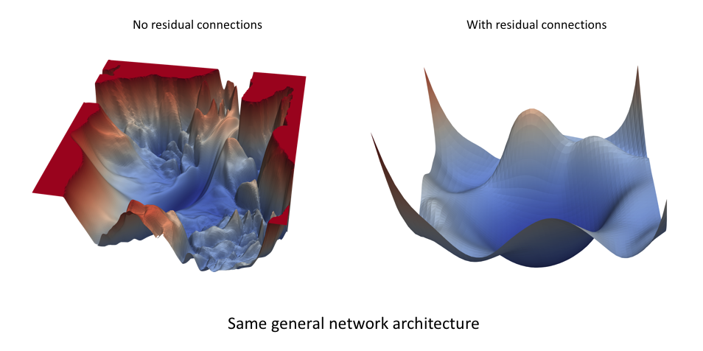
Loss landscape
https://losslandscape.com/
A visual journey of exploration
LL Explorer 1.1 is a tool to explore loss landscapes of deep learning optimization processes, landscapes created with dimensionality reduction techniques and real data.Simulate descent trajectories down the gradients
Live tweaking of descent rate, add stochasticity & other settings
Draw trajectories that stick to the landscapes
View gradient direction/magnitude
Save snapshots with a variety of styles
Access detailed information about each surface
Works from any device and no login is required

Slide 24
+ AdamW
https://pytorch.org/docs/stable/generated/torch.optim.AdamW.html#torch.optim.AdamW
[논문 리뷰] AdamW에 대해 알아보자! Decoupled weight decay regularization 논문 리뷰(1) - 재야의 숨은 초보 (hiddenbeginner.github.io)

Slide 25
Loss functions in PyTorch
nn.L1Loss
nn.MSELoss
nn.CrossEntropyLoss
nn.CTCLoss
nn.NLLLoss
nn.PoissonNLLLoss
nn.GaussianNLLLoss
nn.KLDivLoss
nn.BCELoss
nn.BCEWithLogitsLoss
nn.MarginRankingLoss
nn.HingeEmbeddingLoss
nn.MultiLabelMarginLoss
nn.HuberLoss
nn.SmoothL1Loss
nn.SoftMarginLoss
nn.MultiLabelSoftMarginLoss
nn.CosineEmbeddingLoss
nn.MultiMarginLoss
nn.TripletMarginLoss
nn.TripletMarginWithDistanceLoss

Slide 26
So.. what are we going to use?
Trends
Adam is magic. If you do not know the proper optimizer, just use adam
most of the work of foundation (good theoretical conference prefers SGD)
LARSE -> for huge size of batch sizes (10K, 40K, ...etc)

Slide 27
Scheduling

Slide 28


Learning rate
Learning rate Scheduler - Data Science Stack Exchange

Slide 29


Learning rate scheduling
A Learning rate schedule is a predefined framework that adjusts the learning rate between epochs or iterations as the training progresses. Two of the most common techniques for learning rate schedule are,
Constant learning rate: as the name suggests, we initialize a learning rate and don’t change it during training;
Learning rate decay: we select an initial learning rate, then gradually reduce it in accordance with a scheduler.
schedule it over epoch
https://neptune.ai/blog/how-to-choose-a-learning-rate-scheduler

Slide 30

Setting the learning rate of your neural network. (jeremyjordan.me)

Slide 31
Learning rate scheduler in PyTorch
lr_scheduler.LambdaLR
lr_scheduler.MultiplicativeLR
lr_scheduler.StepLR
lr_scheduler.MultiStepLR
lr_scheduler.ConstantLR
lr_scheduler.LinearLR
lr_scheduler.ExponentialLR
lr_scheduler.CosineAnnealingLR
lr_scheduler.ChainedScheduler
lr_scheduler.SequentialLR
lr_scheduler.ReduceLROnPlateau
lr_scheduler.CyclicLR
lr_scheduler.OneCycleLR
lr_scheduler.CosineAnnealingWarmRestarts

Slide 32

warm up steps
2) 트랜스포머를 이용한 한국어 챗봇(Transformer Chatbot Tutorial) - 딥 러닝을 이용한 자연어 처리 입문 (wikidocs.net)

Slide 33
Optimization references
https://cs.stanford.edu/people/karpathy/convnetjs/demo/trainers.html
시각화 자료 optimizer 비교
https://ruder.io/optimizing-gradient-descent/index.html#adagrad
이건 글,

Slide 34


https://machinelearningmastery.com/understand-the-dynamics-of-learning-rate-on-deep-learning-neural-networks/
이자료 이해하고 그림 추가해도 괜찮을 것 같다.
각 파라미터나 알고리즘이 어떻게 영향을 미치는지 비교하기 쉽게 해두었다.

Slide 35
learning rate scheduling
https://towardsdatascience.com/learning-rate-scheduler-d8a55747dd90
줄글자료
https://www.jeremyjordan.me/nn-learning-rate/
이자료 그림도 좀 있고 참고할만한 듯

Slide 36
https://towardsdatascience.com/learning-rate-schedules-and-adaptive-learning-rate-methods-for-deep-learning-2c8f433990d1
이게 진짜 스케줄링 관련한 자료지 스케줄 알고리즘이랄지

Slide 37
Stochastic Weight Averaging
Averaging Weights Leads to Wider Optima and Better Generalization, UAI 2018
Averaging Weights Leads to Wider Optima and Better Generalization 리뷰 (hoya012.github.io)

Slide 38
Glossaries

